Slide 1
Bank Security
DevSecOps Strategy
2023
Vince King
June 2023
Notes:
How are we securing new agile delivery approaches?

Slide 2


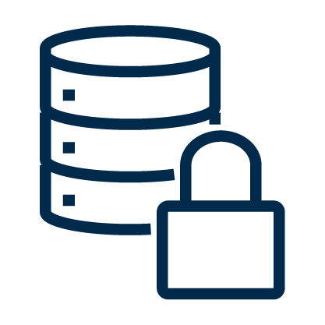

Development Landscape
200+ Developers each with a MSDN license and access professional development tools
600+ developers including analysts and researchers with little or no software engineering experience
400+ Code Repositories with 100,000+ lines of code and 500+ 3rd party packages and access controlled by local teams
13 Deployment Zones using custom and adhoc build and release pipelines on an irregular basis
Notes:
Developers
Employed as software engineers to work within Technology on systems and applications required to meet the Bank’s mission
Each has a MSDN license that gives them access to the Microsoft suite of tooling and free Azure credit
Developers have experience and are supported with software development training
Typically fall into the 80/20 split with the 80% having “on-the-job” security training
Non-developers
Staff from across the Bank including the PRA, MA, Markets & Banking
Technologies include R, Python, PowerShell, and even a smattering of Go
Some work is undertaken as PoC with the idea of moving it to Technology in the future
Causes concern of shadow IT and lack of governance
Version Control
On premise ADOS and 2 new organisations in GitHub (Enterprise)
Code repositories for all “known” code spanning numerous languages
Outdated 3rd party packages stored directly in version control
No automated code scanning enabled
Deployments
Servers in every (non-CNI) zone across 2 data centres
Little or no reporting of usage of deployment capabilities
Few fully automated deployments
Little or no secure scanning during build process

Slide 3

It Never Rains …
Set the scope Cloud projects only, fixing forward, with 80% of apps moving to the cloud by 2030
People Engage with app teams and developers early and work closely with senior devs
Process Insert DevSecOps into the Cloud Attestation process to ensure compliance
Technology Trust but verify using security tooling

Slide 4




DevSecOps Mission
Observe
In DevSecOps we look to achieve continuous security monitoring of our repos, pipelines and automation.
The first step in any security process is to understand what needs to be protected.
Audit
Enabling new policies, controls, and procedures in a mandatory, but “listening only”, non-breaking mode allows us to understand the impact full implementation will have on existing projects.
Enforce
Following a communication campaign, mandatory security workflows will be fully implemented for all repositories and result in failing check-ins/builds for pipelines with failing controls.
Report
Reporting will support post implementation reviews and allow individuals, teams, and security professionals to easily visualise effectiveness.
Notes:
Observe
Establishment of Security Manager role within GitHub organisations
Review of existing repos, permissions, PATs, processes, and workflows
Investigation into native tooling to support an improved security culture within the Developer community
Collaboration with Platform and Toolchain teams to support improvements in DevOps practices
Audit
Definition of tooling, controls, and procedures to applied to all repos
Widespread communication of new controls and procedures and the “audit” mode being used
Application of mandatory controls against a defined scope of projects
Collection of data focusing on issues found in “audit” mode
Enforce
Centralised documentation available for all controls and processes
Communication campaign to inform all developers and users of the changes
Implementation of mandatory workflows for all projects and repos
Continuous review of impact of new controls and workflows
Report
Development of agreed metrics to track effectiveness
Update processes to enable feedback and improvement
Creation of a reporting process for communication
Investigation into future improvements through tooling, and processes

Slide 6
Bank Mission: To promote the good of the people of the UK by maintaining monetary and financial stability.
Cyber Security Mission
To be the world leading central bank in countering the evolving cyber security threat, thereby honouring the trust that the people of the UK place in the Bank to safeguard the nation’s economy.
DevSecOps Mission
To encourage and maintain a focused secure coding and configuration culture across Technology using a pragmatic combination of processes and tooling.

Slide 7
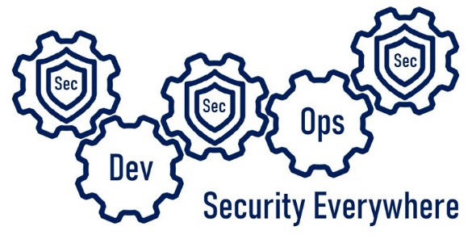
Questions?
Vincent King
Secure Cloud Transformation

Slide 8
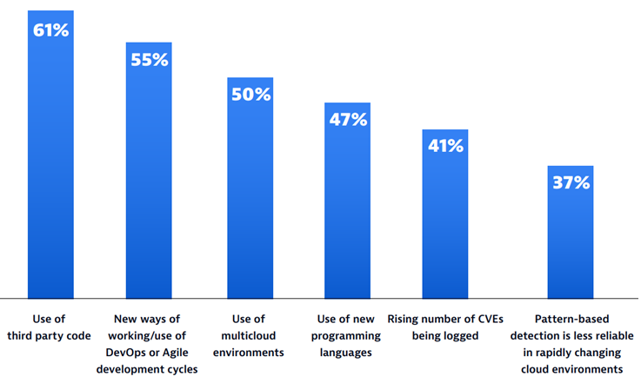
Scary Slide No.1
68%
of apps had a security flaw that fell into the OWASP Top 10
Notes:
In a recent report from Dynatrace (Dynatrace Global CISO report 2023), CISOs were asked to identify factors that made it more difficult to pinpoint and resolve application vulnerabilities.
61% said that the use of 3rd part code caused issues. If we think about Log4J a number of organisations believed they where not exposed until they started to think about the dependencies not just of their only code, but the dependencies of the packages they use, and the exposure their vendors had.
I love the second value … 55% blamed DevOps and Agile. Two of the great innovations in the development world are causing our Cyber leads pain. Development is becoming too efficient and moving too quickly for security to keep up!
Finally, Veracode released some data … a scan of 130,000 applications found that nearly 68% of apps had a security flaw that fell into the OWASP Top 10. Hopefully we are all aware of OWASP (Open Web Application Security Project); the Open Source Foundation regularly revise and publish their top 10 vulnerabilities found in Web apps. The most recent (2021) has broken access control at number 1. Injection (including SQL Injection) is always in the top 10, this time at number 3. So what can we do to help our CISOs sleep better and our developers to avoid some basic mistakes?

Slide 9
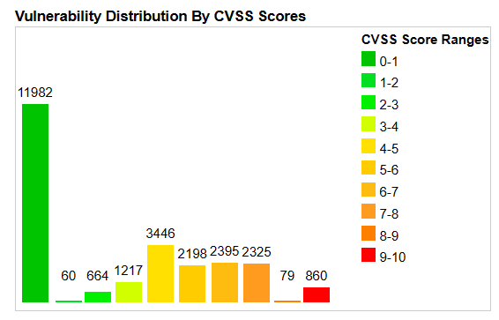
Scary Slide No.2
25,226
Common Vulnerabilities and Exposures (CVEs) were published last year alone.
57%
report that their breaches could have been prevented by installing an available patch
34%
victims knew of the vulnerability, but hadn’t taken action
Notes:
Now we’re in good shape, right? We have a strong secure development culture. We have reliable, repeatable, and secure deployments. What’s left?
25,226 Common Vulnerabilities and Exposures (CVEs) were published last year alone; and increase of 25% from 2021. Almost 70 per day! This year already there are almost 2,000.
Of those 26,000 CVEs 3.4% (860) had a CVSS score between 9 and 10, the most critical.
A report on the State of Application Security (Forrester) tells us that 57% of cyberattack victims report that their breaches could have been prevented by installing an available patch. Even more chilling, 34% of those victims knew of the vulnerability, but hadn’t taken action
74% of companies say they simply can’t patch fast enough because the average time to patch is 102 days according to Ponemon.

Slide 10
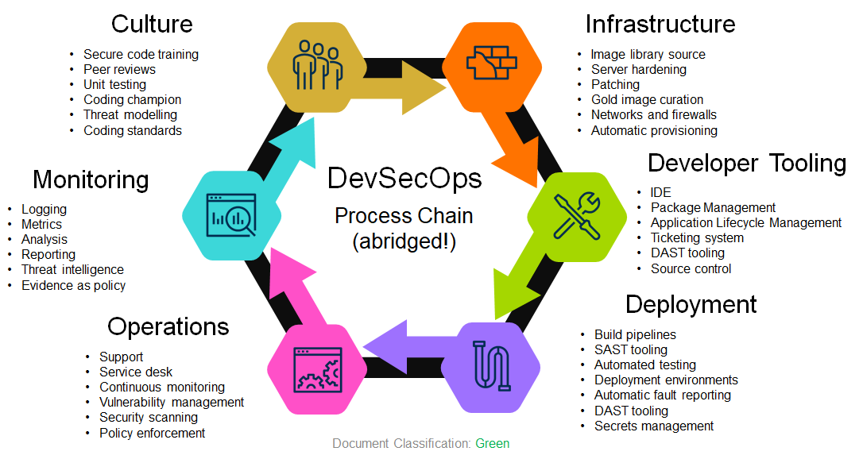
Scary Slide No.3
The DevSecOps
Toolchain
Infrastructure
Culture
Azure Virtual Machines
Amazon Machine Images
GCP Compute Engine
Docker
ECR
Terraform
YAML
Ansible
Chef
SaltStack
AWS CloudFormation
Azure Resource Manager
CIS Benchmarks
SCCM
Qualys Patch Management
Automatic Updates
Code Warrior
Pluralsight
OWASP Top 10
LinkedIn Learning
Udemy
Evil user stories
CERT Secure Coding Standards
Game day exercises
Gerrit
Github pull requests
Review board
JUnit
xUnit
Evil user stories
OWASP Threat Dragon
CERT Secure Coding Standards
Monitoring
Developer Tooling
Azure Defender for Cloud
Azure Sentinel
Splunk
SolarWinds
RSA NetWitness
Archer
ThreatConnect
OWASP Threat Dragon
Chef
HashiCorp Sentinel
nmap
Etsy Morgue
Orca Security
HackerOne
graphite
Wiz.io
NPM
NodeJS
SonarLint
DeepSource
SonarQube
JetBrains
Github
GitLab
BitBucket
Azure DevOps
Github Actions
JIRA
Artifactory
ReSharper
Final warning! Stop it!
VSCode
Operations
Deployment
BMC Remedy
ServiceNow
LinkedIn Learning
Udemy
Evil user stories
OWASP Threat Dragon
CERT Secure Coding Standards
Qualys
Tenable
Spiceworks
BeyondTrust
AWS CloudTrail
Nessus
Seriously … stop reading! You will hurt your eyes.
Jenkins
Azure DevOps
AWS Deploy
VeraCode
Fortify
Selenium
TestComplete
Azure Key Vault
AWS KMS
Atlassian Bamboo
TeamCity
YAML
PowerShell
SARIF SAST Tools
Yarn
Test Management
(VERY abridged!)
Notes:
If you thought the previous slide was overwhelming, then I apologise for this.
There are a lot of vendors and an even greater number of tools that will “do” DevSecOps for you. Just like culture; Start small and build.
Budgets are always a factor, so start with open source tools … remembering to keep them up to date! Prove their worth by creating and tracking metrics that can be communicated across your organisation and show managers the improvements.

